Slide 1
SECURE ANDROID APPLICATIONS

Slide 2

HELLO!
Esa Firman
You can find me at @esafirm in almost everything

Slide 3
WHY MAKES OUR APP SECURE IS IMPORTANT?
Notes:
Security selalu jadi konsiderasi dan concern user
Membuat aplikasi kita aman sama halnya seperti membuat safety belt yang tidak optional bagi user

Slide 4
SO LET’S START WITH OUR PROBLEM

Slide 5
REVERSE ENGINEERING
Decompile APK and modifying something out of it is common in Android Developer or modder community

Slide 6
ROOTED DEVICES
Rooted devices also common in Android users especially in the early days of Android

Slide 7
Problems
The security is low from the start, so we must be extra careful
The good news is, it’s getting better 👍
The bad news is, adoption rate for the new OS is slow
Notes:
Explain why the two point before is our main problem

Slide 8
OK, NOW HERE’S HOW TO MAKE YOUR APP MORE SECURE
Notes:
Kita sudah tau problem kita apa, sekarang ini cara2 biar aplikasi kamu lebih aman

Slide 9
Always Obfuscate
Always upload your application with Proguard or R8 enabled
Don’t turn off your obfuscation
Check your APK with Android Studio before upload!

Slide 10
Always Obfuscate
buildTypes {
release {
minifyEnabled true
proguardFiles getDefaultProguardFile('proguard-android-optimize.txt'), 'proguard-rules.pro'
}
}

Slide 11


Slide 12
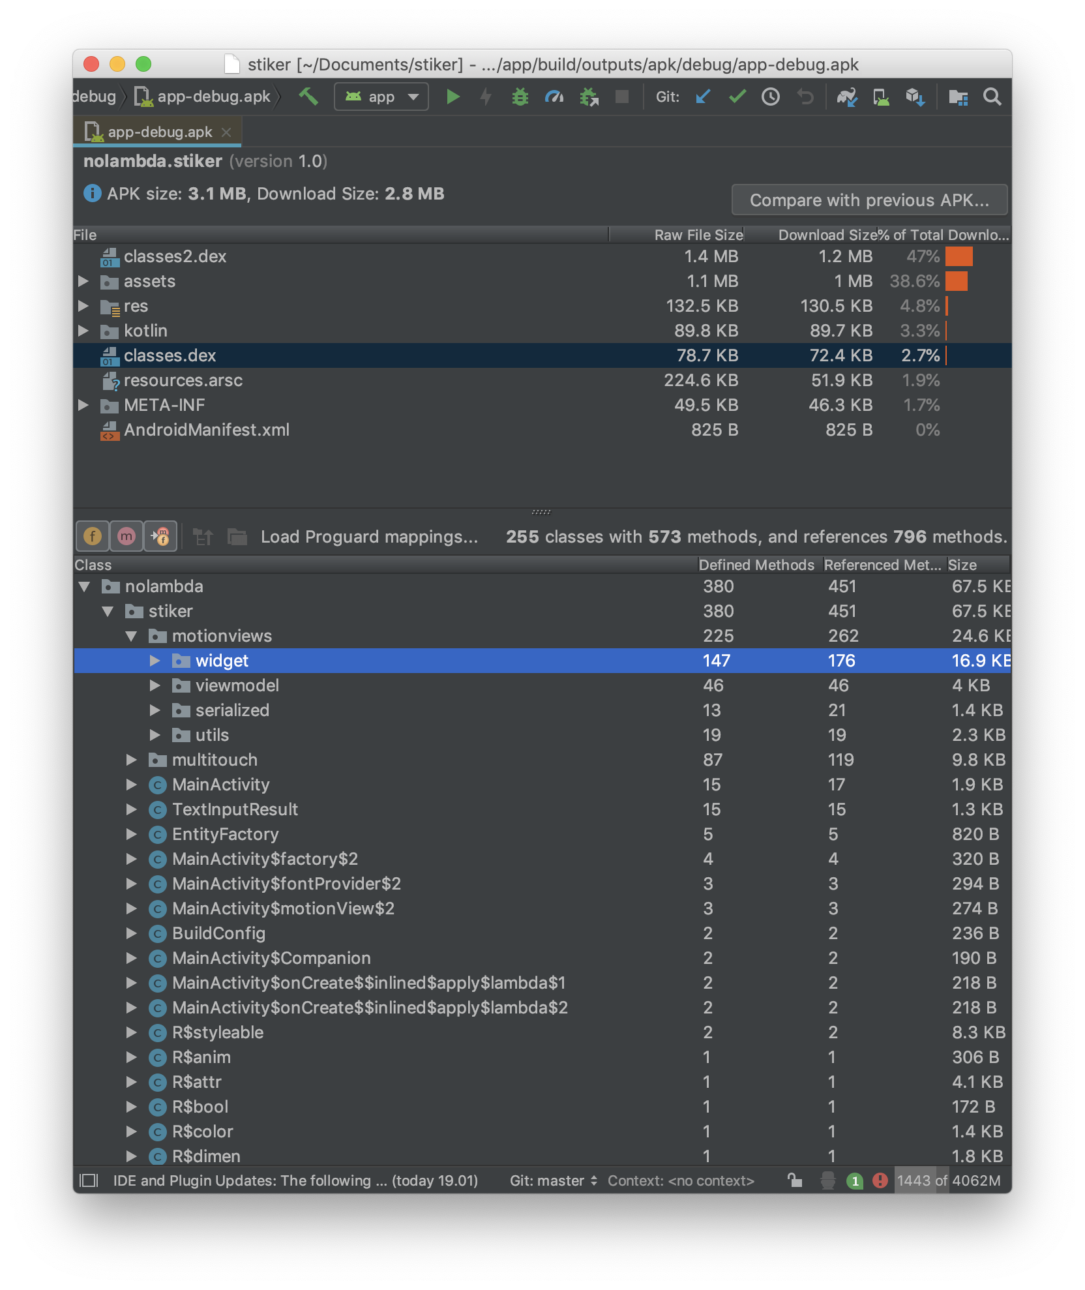

Slide 13
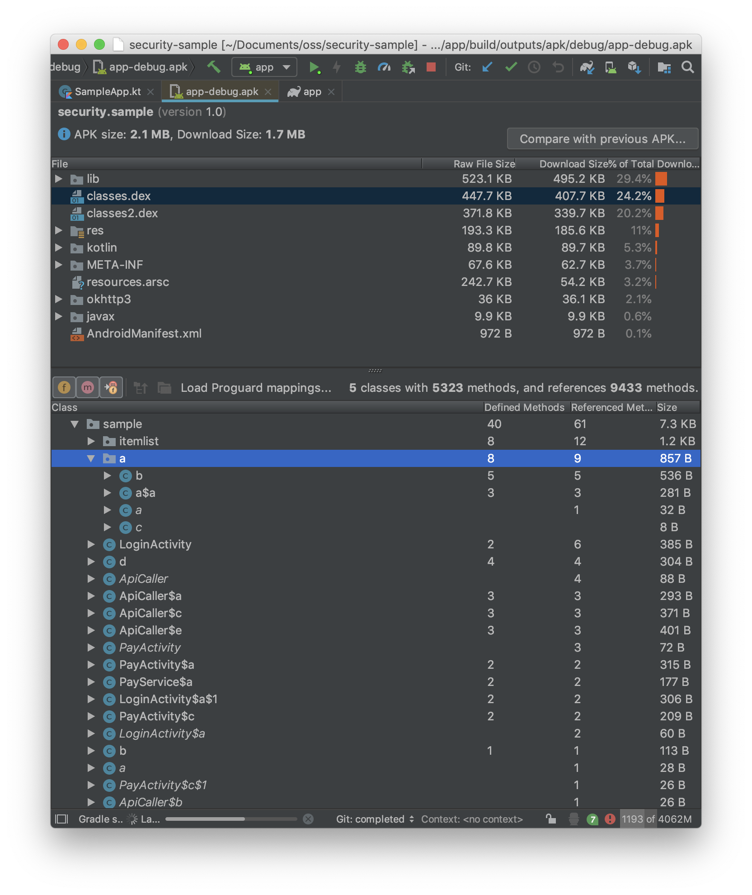

Slide 14
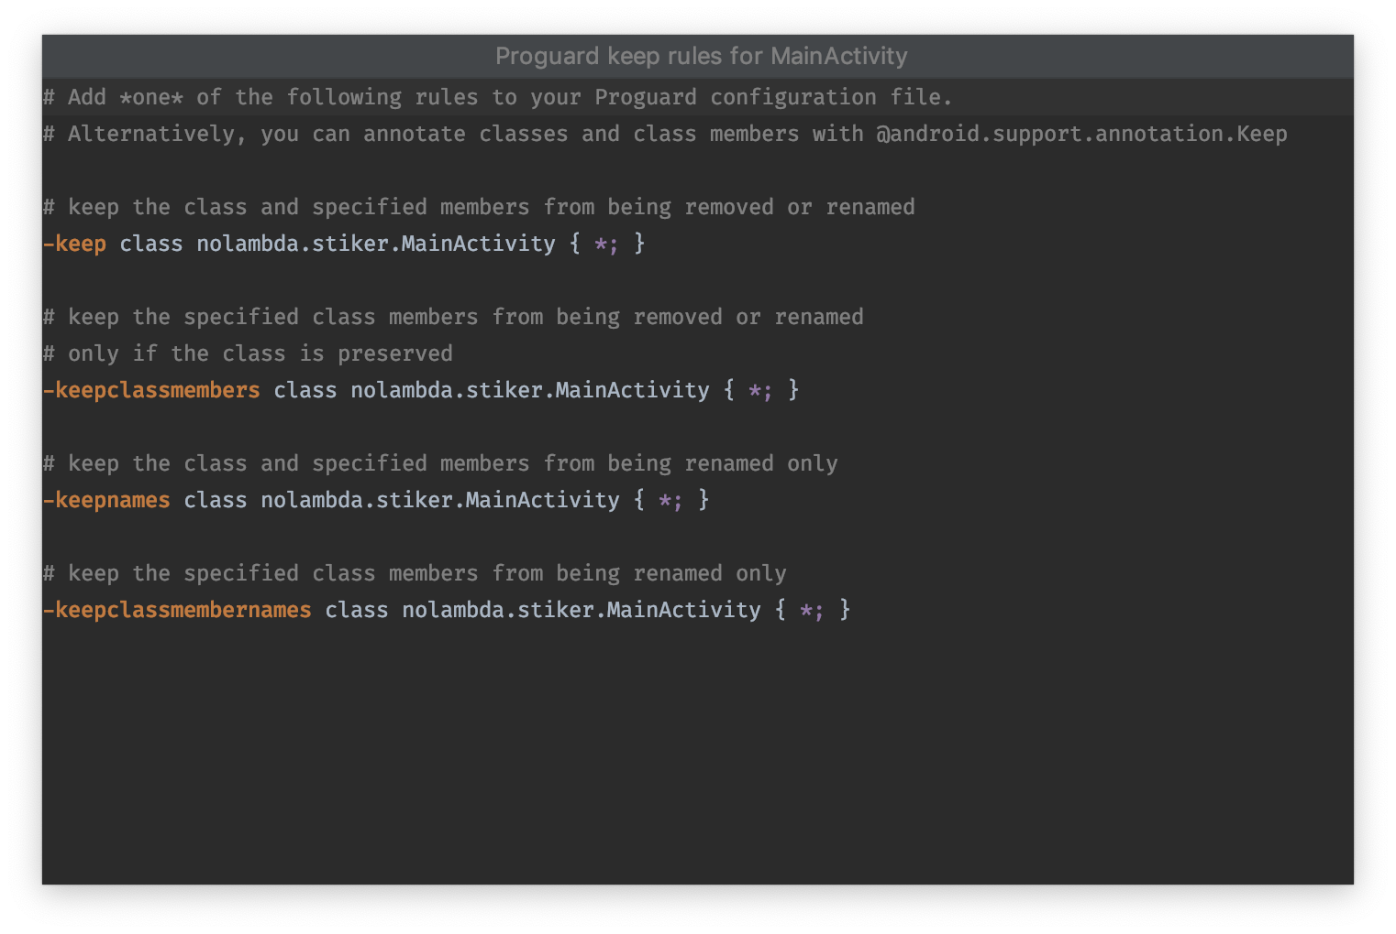
Notes:
You can easily generate proguard rules for your classes

Slide 15
Encrypt your saved data
SharedPreferences is just XML
SQLite saved in SQLite file
Internal and external storage can be accessed
Notes:
Share why you need to encrypt

Slide 16
Options
Hawk
SQLChiper
Android Keystore System
Facebook Conceal
Notes:
Share why you need to encrypt

Slide 17
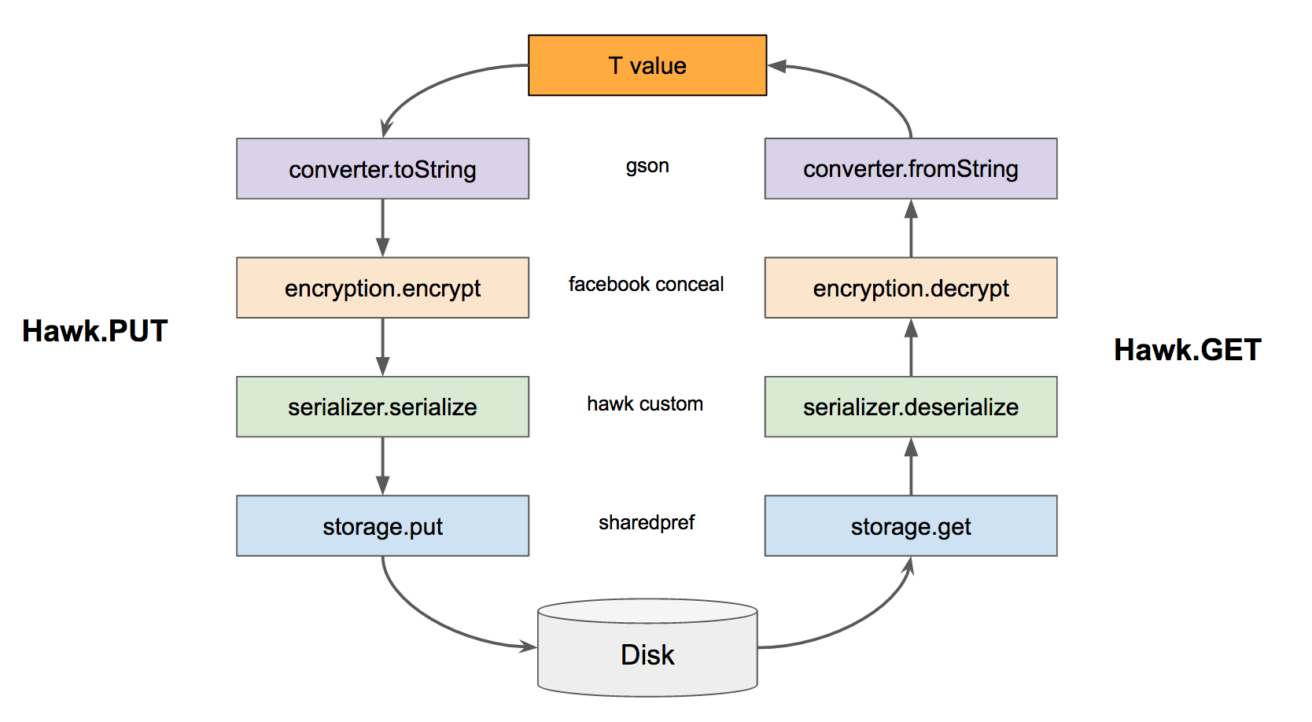
Hawk
Notes:
Share why you need to encrypt

Slide 18
Hawk
Hawk.init(context)
.setEncryption(new NoEncryption())
.setLogInterceptor(new MyLogInterceptor())
.setConverter(new MyConverter())
.setParser(new MyParser())
.setStorage(new MyStorage())
.build();
Hawk.put(key, T); // save
Hawk.get(key); // get
Notes:
Share why you need to encrypt

Slide 19

Comparison
Wow
Notes:
Share why you need to encrypt

Slide 20
Encrypt your private keys
You’re probably still need a passphrase or a key for your encryption process.
If so, hide it!

Slide 21
Options
Disguise or encode your private keys
Hide in Native Libraries with NDK

Slide 22
Disguise or Encode
Base64
Byte Array
Others

Slide 23
Disguise or Encode
"SuperSecretKey"
// Bytes
53 75 70 65 72 53 65 63 72 65 74 4b 65 79
// Base64
U3VwZXJTZWNyZXRLZXk=
// Combination
NTMgNzUgNzAgNjUgNzIgNTMgNjUgNjMgNzIgNjUgNzQgNGIgNjUgNzk=
Notes:
And then you can use Proguard to deobfuscate

Slide 24
Hide in Native Libraries with NDK
class DataLoder {
init { System.loadLibrary("store") }
external fun invokeNativeFunction()
fun requestDataWithKey() {
val key = invokeNativeFunction()
requestData(key) // will request data with key
}
}

Slide 25
Hide in Native Libraries with NDK
#include <string.h>
#include <jni.h>
jstring Java_com_riis_store_DataLoader_invokeNativeFunction(JNIEnv* env,
jobject javaThis) {
return (*env)->NewStringUTF(env, "SuperSecretKey");
}

Slide 26
Or use a Library
// https://github.com/saantiaguilera/android-api-SecureKeys
@SecureKey(key = "secret", value = "aaaa")
class DataLoder {
init { SecureEnvironment.initialize(this) }
fun requestDataWitKey() {
val key = SecureEnvironment.getString("secret")
requestData(key) // will request data with secret key
}
}

Slide 27
Don’t leak yout components
Sometimes what you want is just to make a component that your application use. So make it!
Notes:
This could be the easiest measure but the dumbest if not checked correctly

Slide 28
Don’t leak yout components
<!--service -->
<service
android:name=".DownloadService"
android:exported="false" />
<!--content provider → <provider
android:name="ContentProvider"
android:authorities="com.ahmedabdelmeged.contentprovider"
android:exported="false" />
<!--also applicable to broadcast receiver →
Notes:
This could be the easiest measure but the dumbest if not checked correctly

Slide 29
Turn off your log in production
With Proguard and some rule
Only log if application is debuggable or with BuildConfig.DEBUG
Timber!

Slide 30
With Proguard
-assumenosideeffects class android.util.Log {
public static *** v(...);
public static *** d(...);
public static *** i(...);
public static *** w(...);
public static *** e(...);
}

Slide 31
With Build.DEBUG
object Logger {
fun d(tag: String, message: () -> String) {
if(Build.DEBUG){
Log.d(tag, message())
}
}
}
// Logger.d(TAG) { "Something to log" }

Slide 32
With debuggable
boolean isDebuggable = (0 != (getApplicationInfo().flags
& ApplicationInfo.FLAG_DEBUGGABLE));
object Logger {
fun d(tag: String, message: () -> String) {
if(isDebuggable){
Log.d(tag, message())
}
}
}

Slide 33
With Timber
if (BuildConfig.DEBUG) {
Timber.plant(new DebugTree());
} else {
Timber.plant(new CrashReportingTree());
}

Slide 34
Be extra careful with rooted devices
Log your user with root privileges
Limit what root user can do
Check with Rootbeer!

Slide 35
Check with Rootbeer
// Be careful for false positive!
RootBeer rootBeer = new RootBeer(context);
if (rootBeer.isRooted()) {
//we found indication of root
} else {
//we didn't find indication of root
}

Slide 36
HTTPS for everything
Android P crash every HTTP request by default! 😨
And it is faster too!
HTTP can be easily altered
Some cases even altered by our beloved BUMN

Slide 37
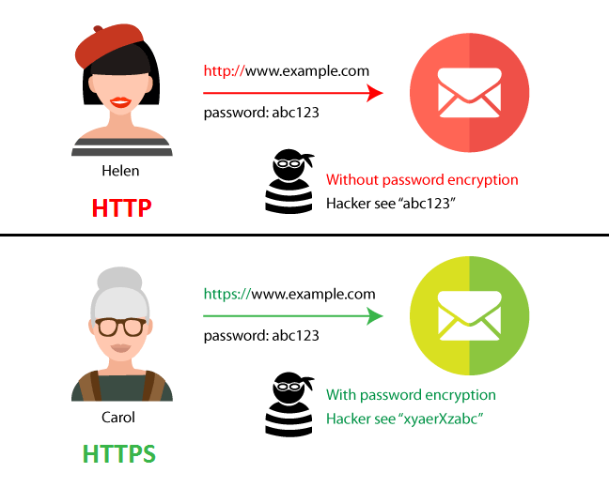
Source: https://seopressor.com/blog/http-vs-https/

Slide 38
Enable certificate pinning
Prevent MITM (man in the middle) attack
Make content sniffing harder
Notes:
Typically certificates are validated by checking the signature hierarchy; MyCert is signed by IntermediateCert which is signed by RootCert, and RootCert is listed in my computer's "certificates to trust" store.
Certificate Pinning is where you ignore that whole thing, and say trust this certificate only or perhaps trust only certificates signed by this certificate.
So for example, if you go to google.com, your browser will trust the certificate if it's signed by Verisign, Digicert, Thawte, or the Hong Kong Post Office (and dozens others). But if you use (on newer versions) Microsoft Windows Update, it will ONLY trust certificates signed by Microsoft. No Verisign, no Digicert, no Hong Kong Post office.
More: https://medium.com/@qomarullah/mengenal-ssl-pinning-untuk-keamanan-aplikasi-mobile-baac5be2ecf6

Slide 39
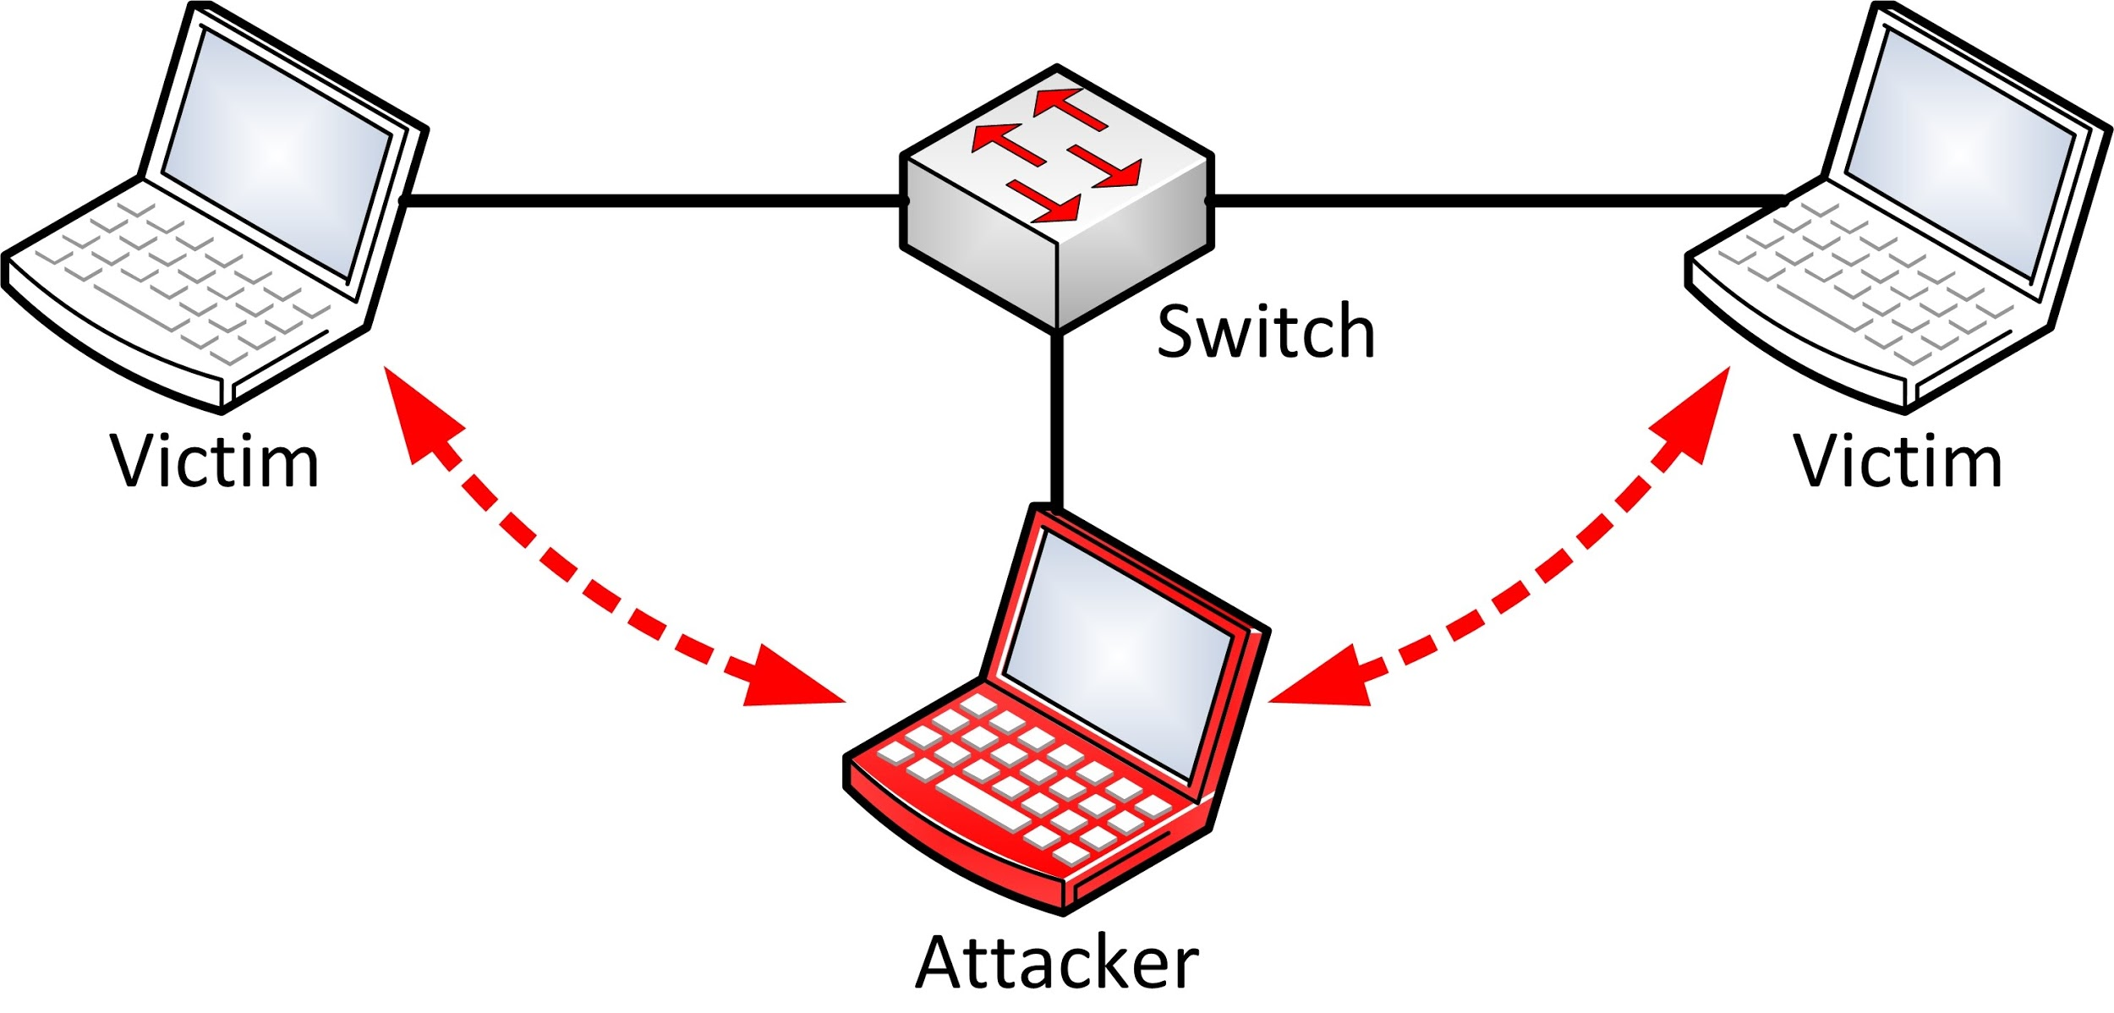
MITM
Notes:
Typically certificates are validated by checking the signature hierarchy; MyCert is signed by IntermediateCert which is signed by RootCert, and RootCert is listed in my computer's "certificates to trust" store.
Certificate Pinning is where you ignore that whole thing, and say trust this certificate only or perhaps trust only certificates signed by this certificate.
So for example, if you go to google.com, your browser will trust the certificate if it's signed by Verisign, Digicert, Thawte, or the Hong Kong Post Office (and dozens others). But if you use (on newer versions) Microsoft Windows Update, it will ONLY trust certificates signed by Microsoft. No Verisign, no Digicert, no Hong Kong Post office.
More: https://medium.com/@qomarullah/mengenal-ssl-pinning-untuk-keamanan-aplikasi-mobile-baac5be2ecf6

Slide 40
Check the Google Play services security provider
Android relies on security Provider to make secure connection
The Provider provides algorithms and key generation process
GMS provides a way to patch this

Slide 41
ProviderInstaller
class MainActivity : Activity(), ProviderInstaller.ProviderInstallListener {
override fun onCreate() {
ProviderInstaller.installIfNeededAsync(this, this)
}
// Provider is up-to-date, app can make secure network calls.
override fun onProviderInstalled() { ... }
// This is reached if the provider cannot be updated.
private fun onProviderInstallerNotAvailable() { ... }
// Resolve error code
override fun onProviderInstallFailed(errorCode: Int,
recoveryIntent: Intent) { ...}
}

Slide 42
Update your dependencies
Check your dependencies version periodically, it sometimes contains security updates
Even dependencies from Google!
Check your SDK as well

Slide 43
Fix your design
Don’t save sensitive data on the device
Don’t make any important transaction on the device
Even in serverless architecture you should make critical data changes in the server

Slide 44
Fix your design
Add PIN or fingerprint authentication for important action

Slide 45

Treat your application security as user story

Slide 46
Credit & References
App security tips https://developer.android.com/topic/security/best-practices#security-provider
Developing secure Android apps https://proandroiddev.com/developing-secure-android-apps-8edad978d8ba
https://security.stackexchange.com/questions/29988/what-is-certificate-pinning
Presentation template by SlidesCarnival
Photographs by Unsplash

Slide 47

THANKS!
Any questions?
You can find me at @esafirm

